Slide 1

Analysis on App Trends - Recommendations for App Trader
Double Wedding Consulting

Slide 2

What We Offer:
10 app recommendations for a fourth of July hot debut
General recommendations for future purchases

Slide 3





The team
Answer the question, “Why are we the ones to solve the problem we identified?”
Eric
Scott
Patrick
Toni Kim
Senior Analyst
Lead Consultant
Senior Analyst
Senior Analyst

Slide 4












Apps for App Trader’s hot debut on Fourth of July
1. Southwest
2. AirBNB
3. Instagram
4. Facebook
5. Uber
6. Dominos
7. Starbucks
8. Doordash
9. Youtube
10. Design Home
Bonus -> Fandango
Hot new movies coming at in July - The Boss Baby: Family Business, The Forever Purge, Summer of Soul, Black Widow, Jungle Cruise, Hotel Transylvania

Slide 5
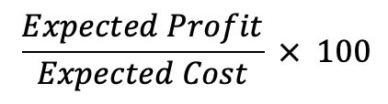
How much profit can these apps make for App Trader?
Name | App’s Lifespan | Expected Profit | Expected Return(%)
Domino's Pizza USA | 11 | $178,000 | 217.11
Design Home | 10 | $160,000 | 214.29
DoorDash - Food Delivery | 10 | $160,000 | 214.29
YouTube Kids | 10 | $160,000 | 214.29
Starbucks | 10 | $160,000 | 214.29
YouTube Kids | 10 | $160,000 | 214.29
Airbnb | 10 | $160,000 | 214.29
Fandango Movies - Times + Tickets | 10 | $160,000 | 214.29
Instagram | 10 | $160,000 | 214.29
Facebook | 9 | $142,000 | 210.94
Southwest Airlines | 8 | $124,000 | 206.9
Uber | 8 | $124,000 | 206.9
** All apps are available in both stores
Expected Percent Return:

Slide 6


Shopping(216.46%)
Photo & Video (208.08%)
Entertainment (206.55%)
** Invest Return = Profit/cost*100
Expected Investment Return
Base on Genre
Entertainment(228.63%)
Education (228.4%)
Comics (226.08%)
Photo & Video (212.14%)
Reference
(212.62%)
Productivity
(213.62%)

Slide 7
4+ (202%)
12+ (201.8%)
9+ (198.8%)
Teen (200%)
Everyone (203%)
10+ (208.2%)
Expected Investment Return
Base on Content Rating
** Invest Return = Profit/cost*100
18+ (230.1%)
10+ (222.5%)
17+ (219.9%)
Notes:
“Everyone 10+” 208.2
“Everyone” 203
“Teen” 200
“Mature 17+” 190.6

Slide 8
$1 or less
(214%)
$1.99
(203%)
$2.99
(190%)
** Invest Return = Profit/cost*100
Expected Investment Return
Base on Price Range
$1 or less (216.9%)
$2 or higher
(146% )
$1-$2
(187.5%)
$2.99
(167.3%)
$1.99
(190.4%)
$1 or less
(212.3%)

Slide 9
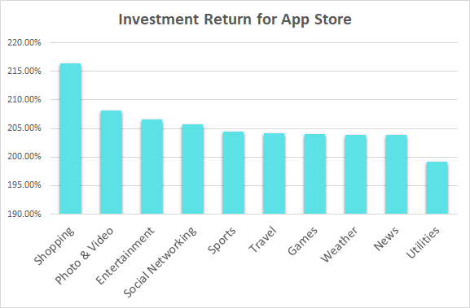
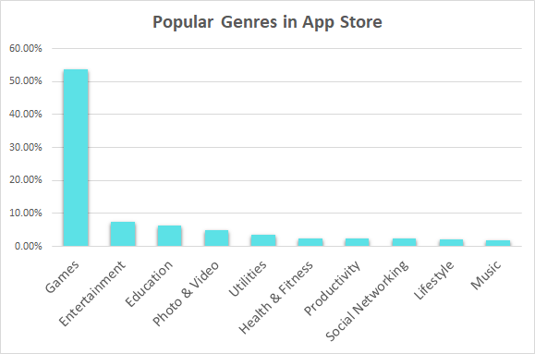
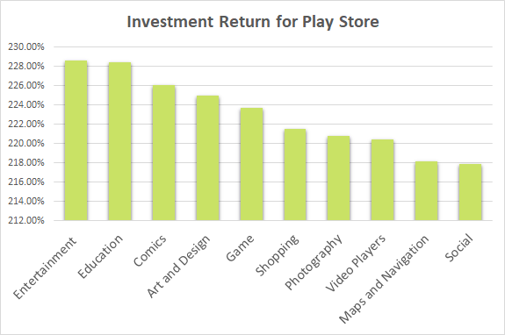
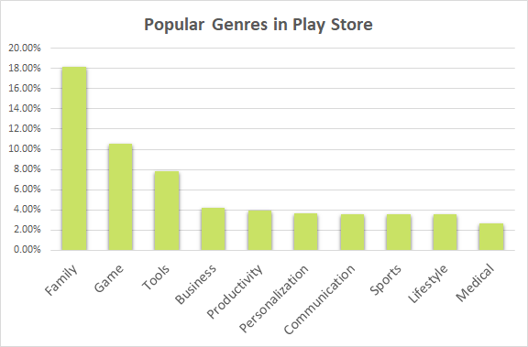

Slide 10
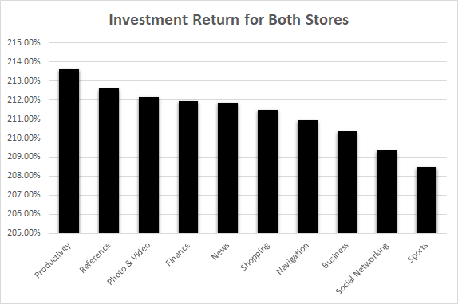
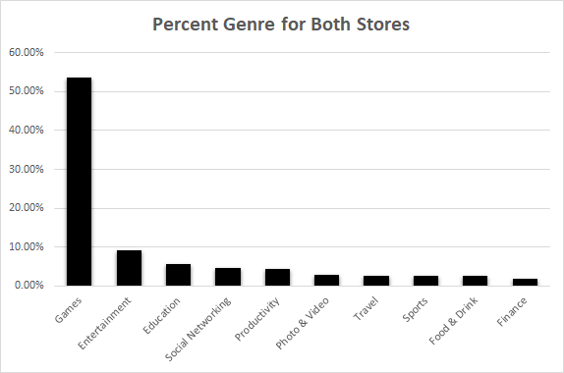


Slide 11
FINAL TAKEAWAYS
STORE | GENRE | CONTENT RATING | USER RATING | PRICE
APPLE | Shopping | 4+ | 4.5 or higher | $1 or less
PLAY | Entertainment | 10+ | 4.5 or higher | $1 or less
BOTH | Productivity | 10+ | 4.5 or higher | $1 or less
Other insights:
Popularity not always good indicator of good investment

Slide 12

Questions?

